Slide 1
Trust-Worthy Online Decision-Making:
Augmenting Online Conversion with Machine-Learned Predictions
---Group 11
Sizhe Li 122090273 Yufei Lei 121090249
Lixin Zhou 123090904 Qingyang Xu 123090691

Slide 2
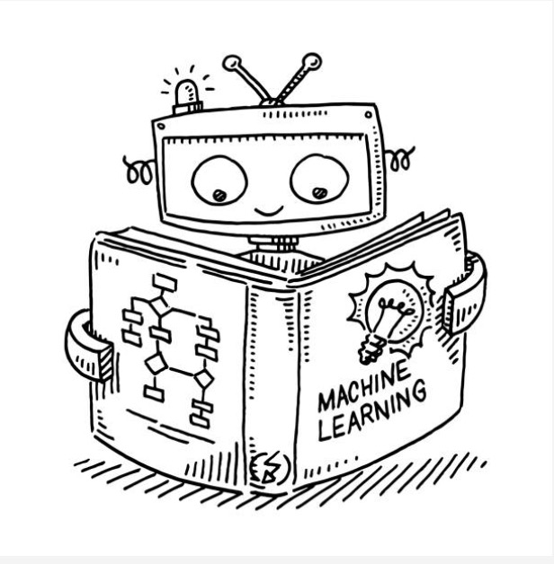
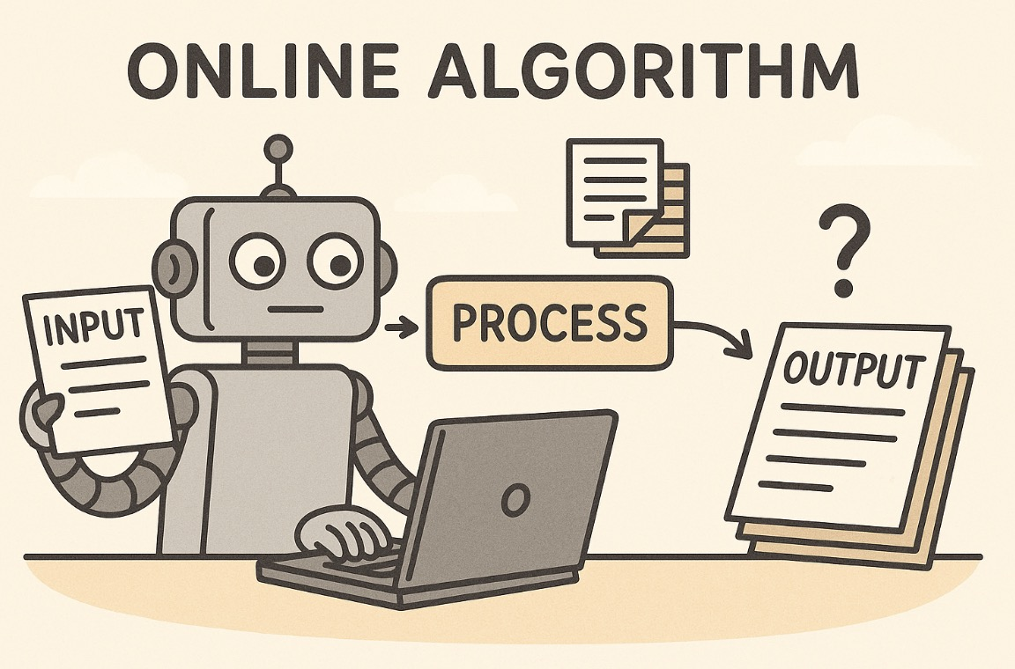
Background & Conflict: Two Extreme Regimes
Blindly Trust
The Machine Learning Regime
Distrust Everything
The Online Algorithm Regime
High Accuracy
Worst-case Guarantees
Unreliable Under Shift
Robust
No Theoretical Guarantees
Conservative & Pessimistic
Powerful in prediction, fragile in action!
Safe in theory, wasteful in reality!
Question: Can we trust predictions just enough—and not too much?

Slide 3







A Novel Framework
Given horizon $T>0$, for each$t≥t_{0}$ ($t_{0}$ is the designated starting time-step),
Historical Data
$$x_{1}, x_{2}, …, x_{t}$$
Prediction $y_{t}$
(Auxilary Information $z_{t}$)
Action /
Decision $a_{t}$
ML Predictor
$$f_{θ}$$
Trust-Aware Mechanism
/ Decision-Making Rule
$$R$$
Goal: $\min_{f_{θ}, R} L\left(x_{1:T}, a_{t_{0}:T}\right)$ [given some loss function $L$]
* Here, we only present a rough idea; the formal mathematical formulation can be found in our report.
* Our framework, Trust-Worthy Online Decision-Making with ML Predictions, can be regarded as a broader generalization of the OMLA (Lykouris et al., 2018 ICML & 2021 JACM).

Slide 4
Two Canonical Online Problems
One-Max Search
day 0
day 1
day 2
day 3
day 4
day 5
day 6
day 7
day 8
10.2
10.9
11.7
11.5
12.6
13.2
14.1
14.7
Stock Price
Hold 1 stock
Hold
Hold
Hold
Sell
Full Conversion: 11.5
One-Way Trading
day 0
day 1
day 2
day 3
day 4
day 5
day 6
day 7
day 8
10.2
10.9
11.7
11.5
12.6
13.2
14.1
14.7
Stock Price
Hold 1 stock
Hold
Hold
Sell 30%
Hold
Sell 20%
Sell 50%
Full Conversion:12.63
Online Conversion Problems (Sell only, no buy):
One-Max Search: Sell once, maximize price
One-Way Trading: Sell fractions, maximize total value
Forced sell at the final day if no earlier action.

Slide 5
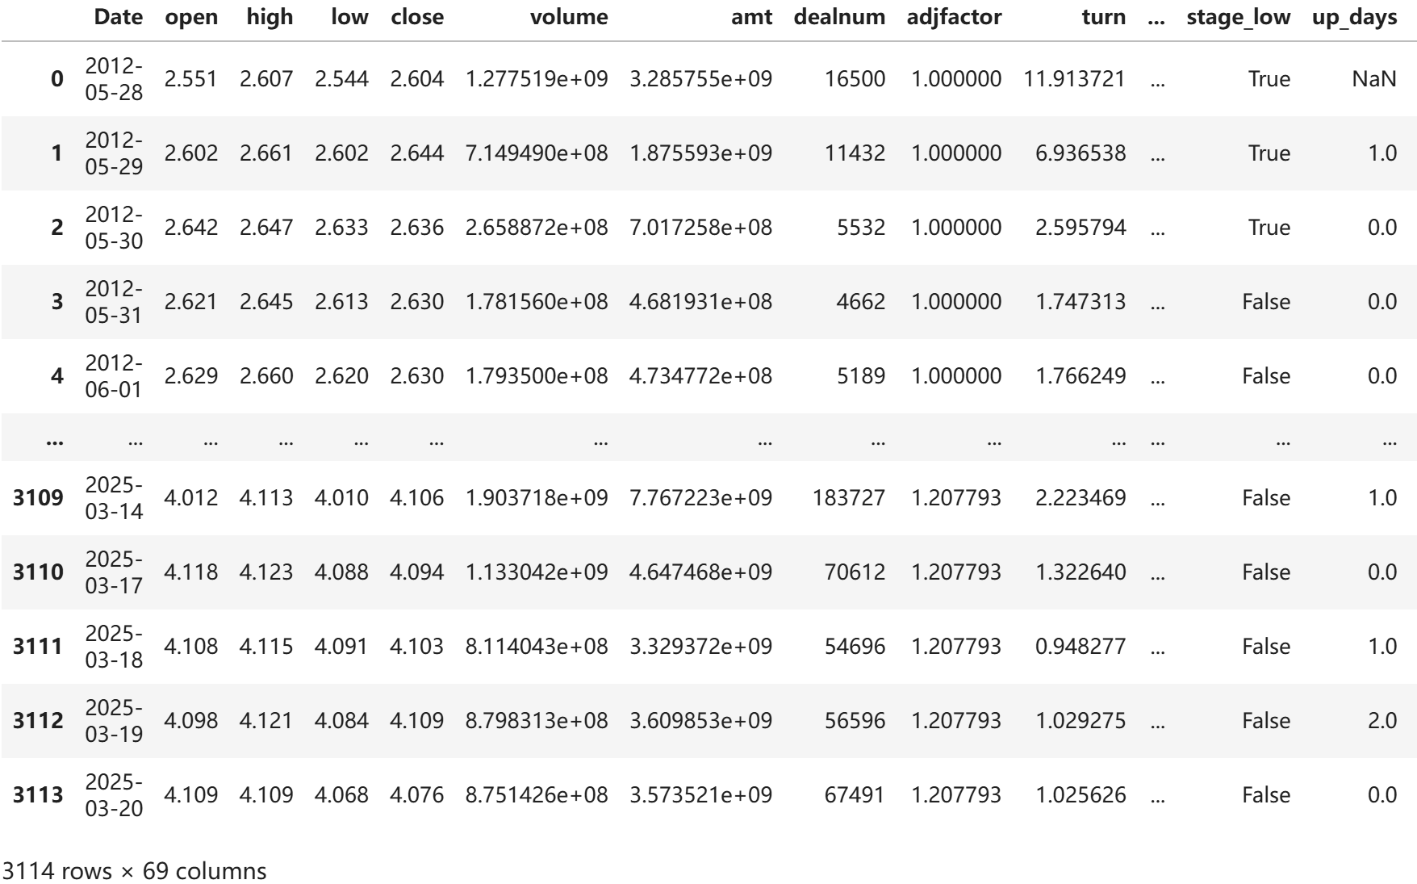
Data Collection & Preprocessing
Data Collection
CSI 300 [2012– 2025]*
Data Preprocessing
Replace NaN with avg
Select useful features
Create Target column
Transformation of Target*
Data splitting
(Training, Validation, Testing)
*CSI 300, “沪深 300” in Chinese, is a capitalization-weighted stock market index designed to replicate the
performance of the top 300 stocks traded on the Shanghai Stock Exchange and the Shenzhen Stock Exchange.
*Transformation of Target: For example, in the task of predicting the maximum price over the next n days,
we observe that the target distribution is right-skewed. To address this issue, we apply a log transformation.

Slide 6
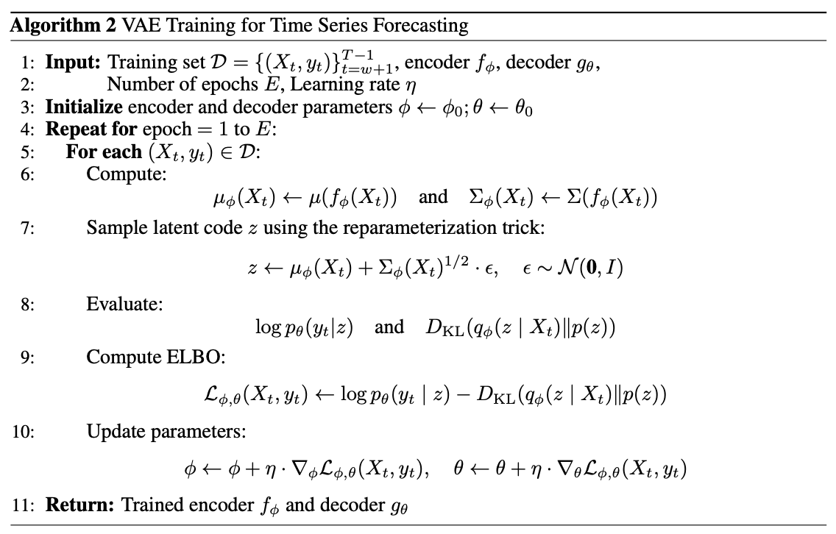
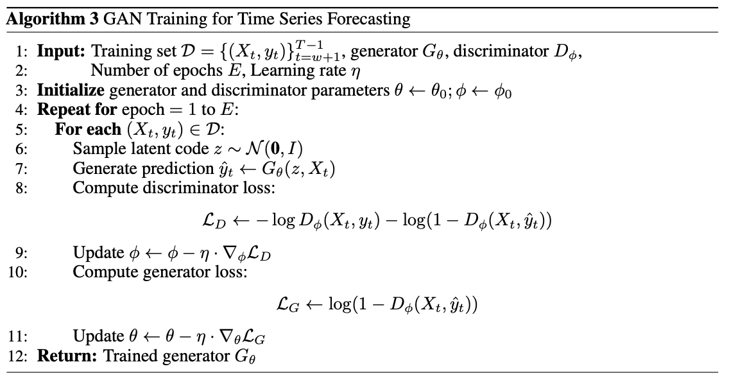
Predictive ML Models for Time Series Forecasting
Generative Models (VAE and GAN):
VAE
GAN

Slide 7
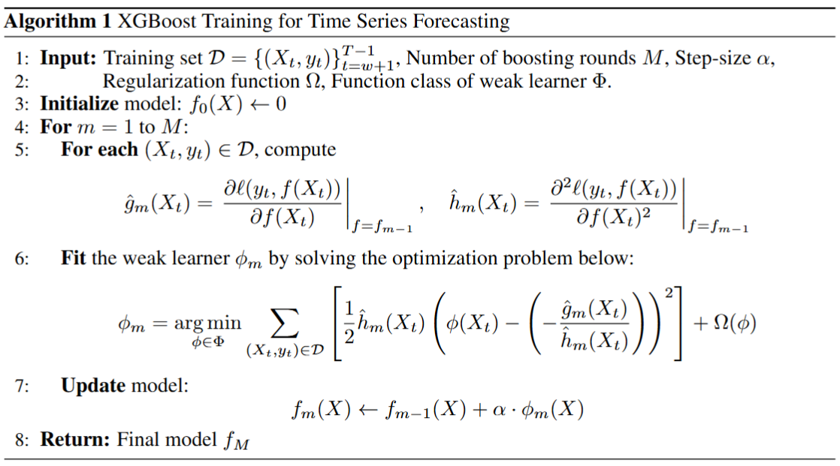
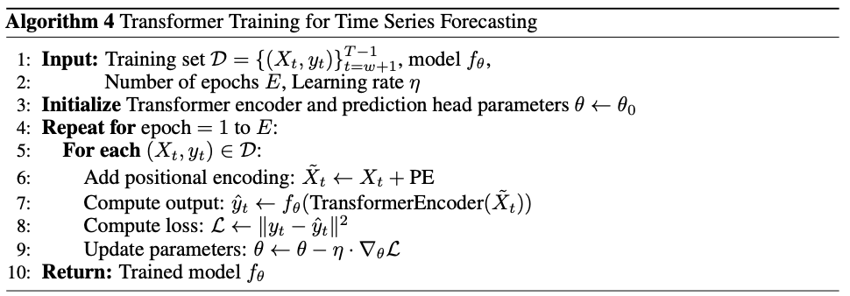

Predictive ML Models for Time Series Forecasting
Transformer and XGBoost:
Transformer
XGBoost
$$φ_{m} = arg\min_{φ∈Φ}{\sum{l(y_{t }}}, f_{m−1}(X_{t}) + φ(X_{t})) + Ω(φ).$$

Slide 8
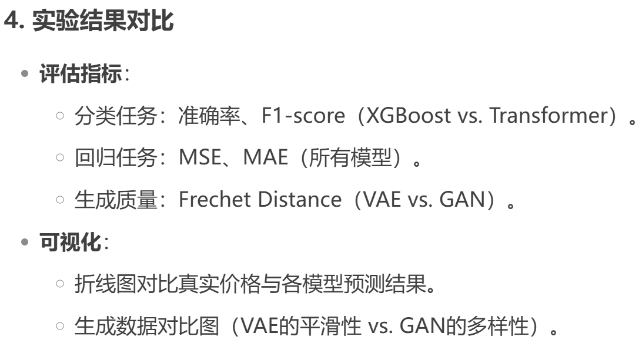
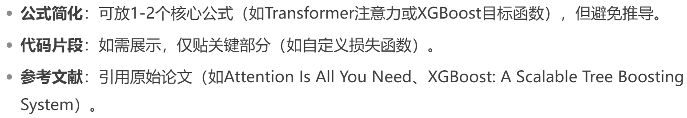
Predictive ML Models for Time Series Forecasting
wok怎么做到的小姐姐教教？怎么打
硬打。我是原始人
插入，公事
不行也得行。

Slide 9



Why trust matters – A simple ML failure case
Use One-Max Search with maximum price prediction over future 10 days
as a illustrative example:
Predicted maximum price over the next 10 days: $y=13.0$,
Blindly trusting it, we set the threshold at $Φ=13.0$.
day 0
day 1
day 2
day 3
day 4
day 5
day 6
day 7
day 8
day 9
day 10
10.2
10.9
11.8
12.3
12.9
12.7
11.8
11.0
10.3
9.7
Stock Price
Hold 1 stock
($<Φ)$
($<Φ)$
($<Φ)$
($<Φ)$
($<Φ)$
($<Φ)$
($<Φ)$
($<Φ)$
($<Φ)$
Hold
Hold
Hold
Hold
Hold
Hold
Hold
Hold
Hold
Forced sell
Is it a good ML prediction? Yes — Prediction(13.0) v.s. true maximum (12.9) [Very Close]
Is it a good online decision? No — Offline Optimum (12.9) v.s. Online Outcomes (9.7)[Lowest]
A good prediction does not necessarily guarantee a good decision！

Slide 10
Trust-Aware Design & Metrics
Classic Metrics*:
Consistency: The performance when the predictions when 100 % accurate.
Robustness: The worst-case guarantee, regardless of prediction quality
In this work, we propose a generalization of the canonical notions:
1. Prediction-specific consistency & Robustness:
Metrics that evaluate consistency and robustness relative to the given prediction.
2. $ε−$consistency & Prediction-specific $ε−$consistency:
Relaxed versions of consistency metrics, allowing controlled tolerance for prediction errors.
*Originated in (Lykouris et al., 2018 ICML & 2021 JACM; Kumar et al., 2018 Neurips).
*Here, we only present a high-level idea, the formal mathematical definitions are detailed in our report.

Slide 11
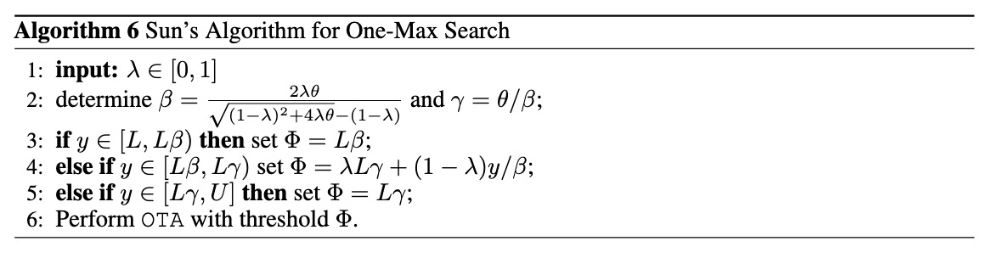
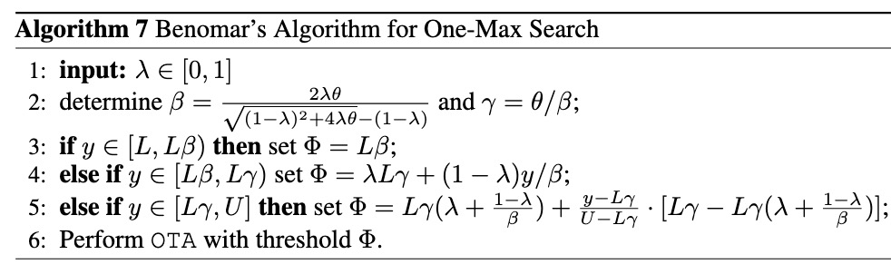

Trust-Aware Design: One-Max Search
In One-Max Search, we consider maximum price prediction over the next n days.
Given the time horizon $T>0$, we assume that the stock price $v_{t}∈\left[L, U\right], ∀ t∈\left[T\right].\left(θ:=\frac{U}{L}\right)$*
Some prior works have studied this problem:
(El Yaniv et al., 2001 Algorithmica)
(Sun et al., 2021 Neurips)
(Benomar et al., 2025 arvix.)
The optimal
competitive algorithm
A learning-augmented algorithm with
Pareto optimal consistency and robustness
The smooth variant of
Sun et al.’s Algorithm
Online Threshold-based Algorithm
with $Φ=\sqrt{LU}$
*It is well known that without the boundedness assumption (i.e., known lower and upper bounds L and U), no meaningful
theoretical results can be obtained in the Online Conversion Problem. (El Yaniv et al., 1998 Algorithmica)

Slide 12
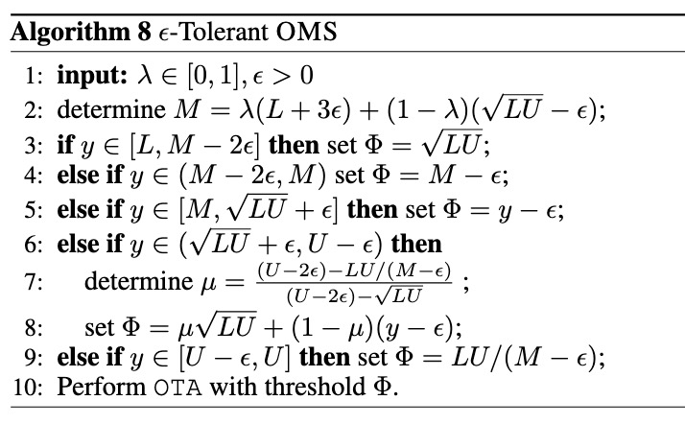
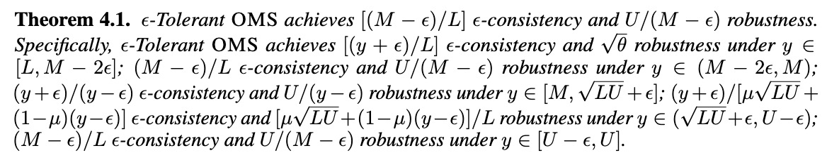
Trust-Aware Design: One-Max Search
In this work, we introduce a new algorithm for this problem, called the $ε−$Tolerant OMS.
We establish three theorems to demonstrate the theoretical
guarantees of our epsilon-tolerant OMS algorithm.
*Our algorithm is based on a completely different intuition from existing methods.
*The crux of the algorithm design and the proofs of the theorems are relatively technical and thus deferred to our report.

Slide 13
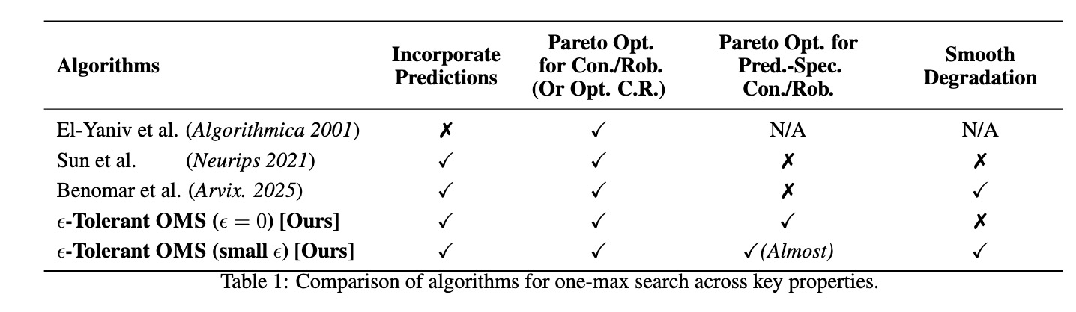
Trust-Aware Design: One-Max Search
We conduct a theoretical comparison between our algorithm and existing methods, demonstrating its superior guarantees.

Slide 14
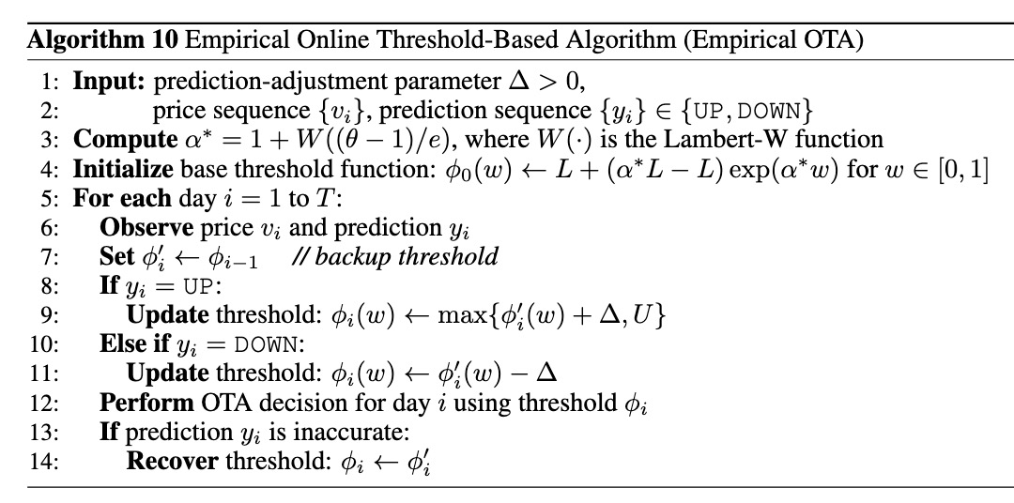
Trust-Aware Design: One-Way Trading
In the One-Way Trading problem, we consider directional movement prediction of tomorrow’s price (UP/DOWN). However, since such predictions are too myopic, no theoretical guarantees can be established. Thus, we focus on designing an algorithm that performs well empirically.
Our Algorithm: Empirical OTA
1. Prediction-guided threshold adjustment
2. Backup and recovery for wrong predictions
*The backbone of our algorithm design is largely inspired by (Sun et al., 2021 SIGMETRICS). The core idea is closely
connected to Yao’s minimax principle (Yao, 1977 FOCS) and the equalizing strategies (Roughgarden, 2007 Book)
commonly used in algorithmic game theory.

Slide 15
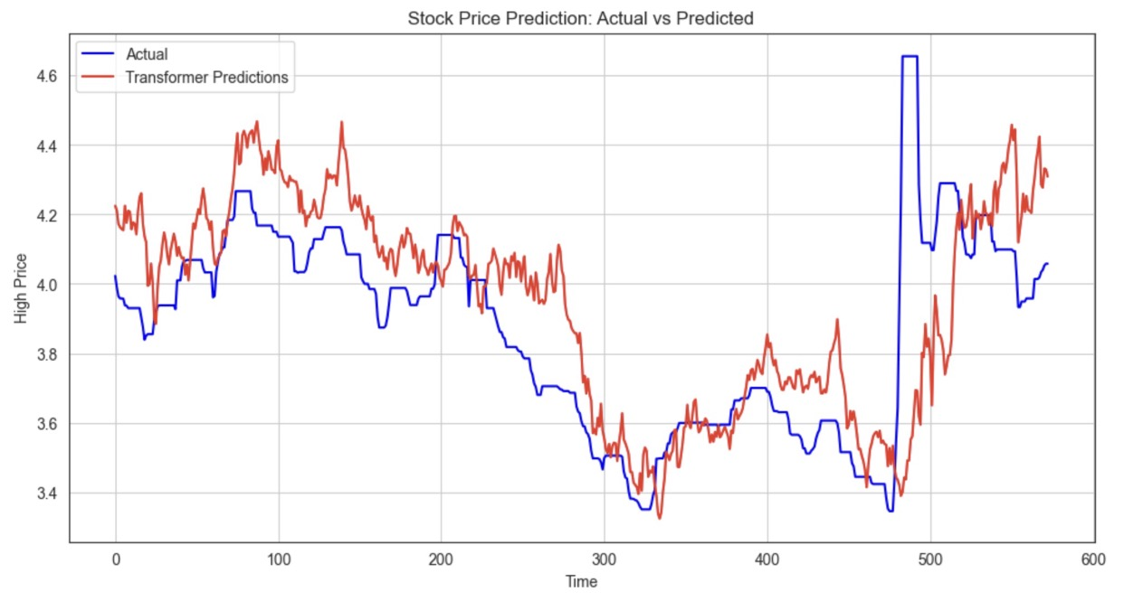
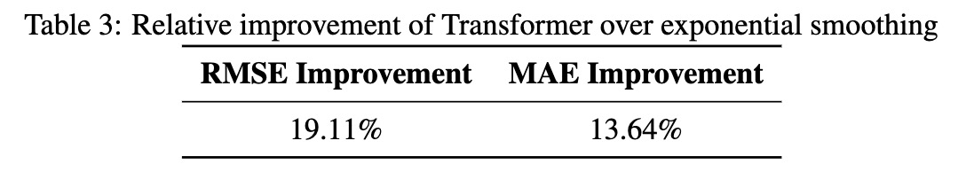
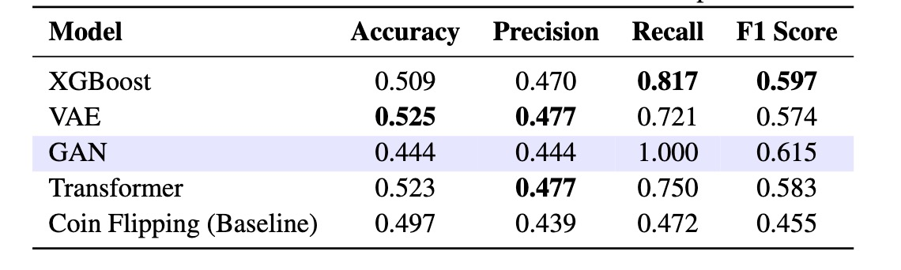
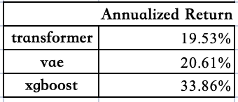
Experimental Results: Machine Learning
Maximum Price Prediction
Directional Movement Prediction
If two-way trading is allowed
*In Directional Movement Prediction, we observe mode collapse in GANs. Considering the highly complex, non-stationary,
and noisy nature of stock market data, such behavior is both reasonable and anticipated.

Slide 16
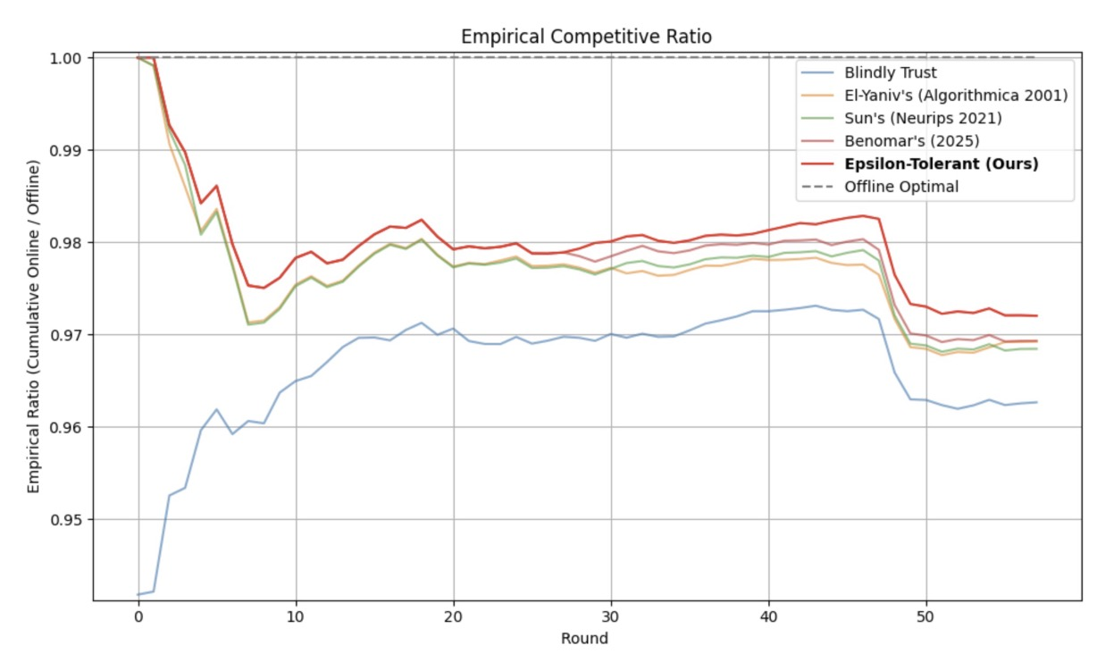
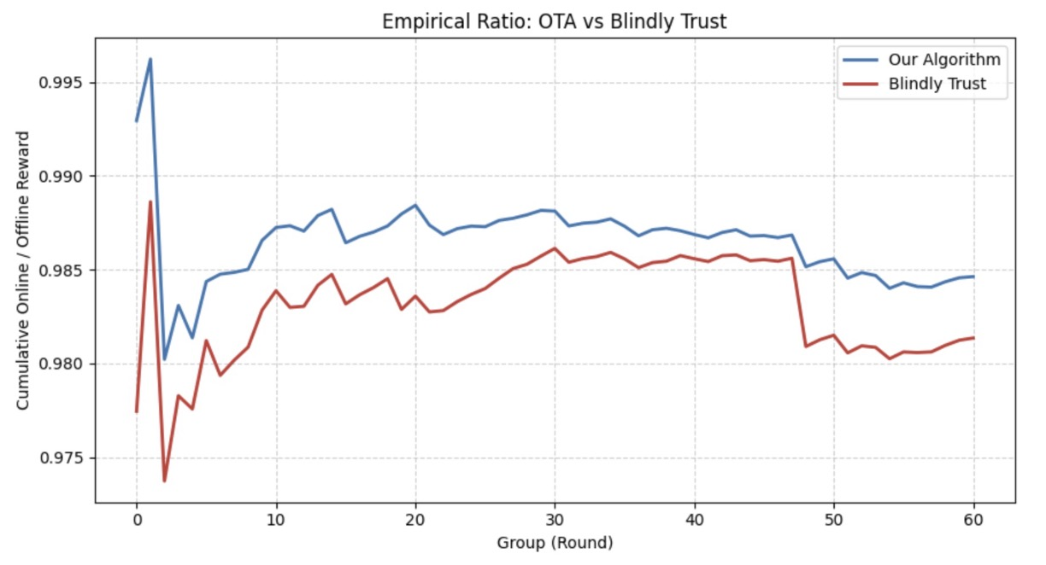
Experimental Results: Trust-Aware Mechanism
One-Max Search with
Maximum Price Movement
One-Way Trading with
Directional Movement Prediction
*Evaluation Metrics: Empirical Competitive Ratio (defined as the cumulative ratio between online outcomes
and offline optimum)

Slide 17
Future Directions
1. End-to-End Integration of ML Predictions and Trust-Aware Mechanisms
We observe that recent work, such as Online Algorithms with Uncertainty-Quantified Predictions (Sun et al., ICML 2024), explores leveraging auxiliary information (e.g., reliability estimates) to improve online decision-making.
Additionally, refining ML loss functions in the training process to better align with online performance objectives is a promising research direction.
2. Extending of Our Framework to Broader Classes of Online Problems
Our framework can potentially be extended to more general online decision-making problems, such as Metrical Task Systems (MTS). Recent works (Christianson et al., 2023 AISTATS; Antoniadis et al., 2023 ICML) have studied robustness-consistency tradeoffs in MTS settings, suggesting that trust-aware mechanisms could play a crucial role in designing learning-augmented online algorithms under complex cost structures.

Slide 18
Don’t trust too much, don’t trust blindly. Trust wisely!
--- we sincerely appreciate your valuable time and attention!
(On behalf of Group 11)
---Group 11
Sizhe Li 122090273 Yufei Lei 121090249
Lixin Zhou 123090904 Qingyang Xu 123090691

Slide 19
References:
Antoniadis, A., Das, S., Gupta, S., and Singla, S. (2023). Learning-Augmented Metrical Task Systems: A Consistency-Robustness Trade-off. Proceedings of the 40th International Conference on Machine Learning (ICML 2023).
Benomar, Z., Perchet, V., Croissant, L., and Angelopoulos, S. (2025). Pareto-Optimality, Smoothness, and Stochasticity in Learning-Augmented One-Max-Search. arXiv preprint arXiv:2502.05720.
Christianson, C., Emamjomeh-Zadeh, E., Ligett, K., and Rubinstein, A. (2023). Optimal Robustness-Consistency Tradeoffs for Learning-Augmented Metrical Task Systems. Proceedings of the 26th International Conference on Artificial Intelligence and Statistics (AISTATS 2023).
El-Yaniv, R. (1998). Competitive Solutions for Online Financial Problems. Algorithmica, 22(4), 362–381.
El-Yaniv, R., Fiat, A., Karp, R. M., and Turpin, G. (2001). Optimal Search and One-Way Trading Online Algorithms. Algorithmica, 30(1), 101–139.
Kumar, R., Purohit, M., and Svitkina, Z. (2018). Improving Online Algorithms via ML Predictions. Advances in Neural Information Processing Systems (NeurIPS 2018).
Lykouris, T., and Vassilvitskii, S. (2018). Competitive Caching with Machine Learned Advice. Proceedings of the 35th International Conference on Machine Learning (ICML 2018).
    — Extended version: Lykouris, T., and Vassilvitskii, S. (2021). Competitive Caching with Machine Learned Advice. Journal of the ACM (JACM).
Roughgarden, T. (2007). Algorithmic Game Theory. Cambridge University Press.
Sun, B., Lee, R., Hajiesmaili, M., Wierman, A., and Tsang, D. H. K. (2021). Pareto-Optimal Learning-Augmented Algorithms for Online Conversion Problems. Advances in Neural Information Processing Systems (NeurIPS 2021).
Sun, Y., and Wu, X. (2021). Learning-Augmented Online Algorithms under Gradual Input Drift. Proceedings of the ACM on Measurement and Analysis of Computing Systems (SIGMETRICS 2021).
Sun, Y., Wang, J., and Wu, X. (2024). Online Algorithms with Uncertainty-Quantified Predictions. Proceedings of the 41st International Conference on Machine Learning (ICML 2024).
Yao, A. C. (1977). Probabilistic Computations: Toward a Unified Measure of Complexity. Proceedings of the 18th Annual Symposium on Foundations of Computer Science (FOCS 1977).

